Slide 1
19CSE313 – Principles of Programming Languages
Programming Paradigms

Slide 2
Programming paradigm
Paradigm: A pattern or model
Programming Paradigm: A Pattern or model of Programming
A fundamental Style of Computer Programming

Slide 3
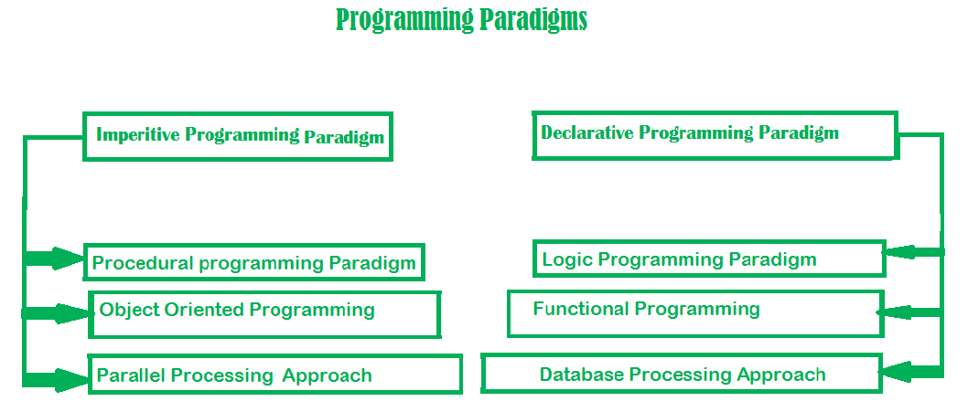
Types of programming paradigms

Slide 4
Imperative paradigm
One of the oldest programming paradigm
Works by changing the program state step by step through assignment statements
Consists of a set of commands for the computer to perform
Describes how the inputs are given and outputs are obtained
Example: C,C++, Java, Python, Ruby etc.
Advantage | Disadvantage
Simple to implement | Complex problems cannot be solved
Contains loops,variables etc. | Less efficient and less productive
 | Parallel programming is not possible

Slide 5
Procedural programming paradigm
Emphasizes on procedure in terms of under lying machine model
No difference in between procedural and imperative approach
Has the ability to reuse the code
Example: C,C++, Java

Slide 6
Object oriented programming
Program is written as a collection of classes and object which are meant for communication
The smallest and basic entity is object and all kind of computation is performed on the objects only.
More emphasis is on data rather procedure.
Can handle almost all kind of real life problems
Advantages: Data Security, Inheritance, Code Reusability, Abstraction and Flexibility
Example: C++, Java, Python, Ruby etc.

Slide 7
Parallel processing approach
Processing of program instructions by dividing them among multiple processors
Lesser Execution Time
Divide and Conquer based approach
Example: Java

Slide 8
Declarative paradigm
Style of building programs that expresses logic of computation without talking about its control flow
Often considers programs as theories of some logic
focuses is on what needs to be done rather how it should be done
Imperative (how to do) and declarative (what to do)
Categorised as Logic, Functional and Database

Slide 9
Logic programming paradigm
An abstract model of computation
To solve logical problems like puzzles, series etc.
Main emphasize is on knowledge base and the problem
Program execution is very much like the proof of a mathematical statement
Example: Prolog
sum of two number in prolog:
predicates
sumoftwonumber(integer, integer)
clauses
sum(0, 0).
sum(n, r):-
n1=n-1,
sum(n1, r1),
r=r1+n

Slide 10
Functional programming paradigm
Has its roots in mathematics
Language independent
Key principle - execution of series of mathematical functions
Functions are the central model of abstraction
Functions are meant for specific computation
Data are loosely coupled to functions
Functions hide their implementation
Functions can be replaced with their values without changing the meaning of the program
Example: Perl, Javascript, Haskell, Scala, Erlang, Lisp, ML, Clojure etc.

Slide 11
database
Programming methodology is based on data and its movement
Program statements are defined by data rather than hard-coding a series of steps.
DB is the heart of a business information system
Provides file creation, data entry, update, query and reporting functions
Several programming languages are developed mostly for database application
Example: SQL
Applied to streams of structured data, for filtering, transforming, aggregating (such as computing statistics), or calling other programs.
CREATE DATABASE databaseAddress; CREATE TABLE Addr ( PersonID int, LastName varchar(200), FirstName varchar(200), Address varchar(200), City varchar(200), State varchar(200) );

